Slide 1

Name : Abdul Ghani Khan Roll No : 22P-9037 BS CS – 2A Final Presentation OF English Lab Instructor : Sir Basit

Slide 2

Impact Of social media on society
ABDUL GHANI KHAN

Slide 3
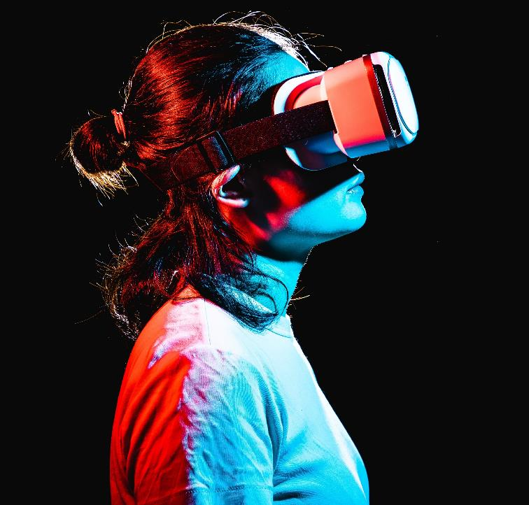
INTRODUCTION
Social media refers to online platforms and tools that allow users to create, share, and exchange information and content with others in virtual communities. Society, on the other hand, refers to the broader network of individuals.
Social media and society are deeply interlinked as social media has become an integral part of modern society, enabling people to connect, communicate, and collaborate in unprecedented ways

Slide 4
POSITIVE IMPACTS OF SOCIAL MEDIA
Social change
Online Learning
Social Media has played a fantastic role when it comes to serving the society , for instance when it comes to gathering donations , one post can change one’s life.
The biggest example of online learning is Youtube , anyone regardless of their age , can learn anything from scratch on Youtube and many more websites like Youtube.
Connectivity & Communication
Collaboration
In Early Age people used to send mails now they have become e-mails and even more advanced versions can be simply WhatsApp , we can simply inform others in just a few clicks.
Modern Day social media has made collaboration really easy , for instance in a software house multiple software engineers can work on a single project with the help of github.

Slide 5
NEGATIVE IMPACTS OF SOCIAL MEDIA
Spread of misinformation
Cyber bullying and harassment
addiction
Social isolation and mental issues
As anyone can post anything on the social media there is a high rate of the spread of misinformation.
On most social media platforms people stay anonymous and with that it becomes easy for them to bully and harass other online as it somehow gives them the power of invisibility.
The use of social media can be sometimes additive , Try a day without the use of your smartphone you will realize what social media addiction is as we have been so dependent on social media
As from the name SOCIAL MEDIA , one can say that it will make you social but in most cases it’s the complete opposite and people stay isolated in their rooms specially in families not talking to each others while chatting with their online friend
And Sharing less with your family can cause mental problems

Slide 6
DISADVATAGES OF SOCIAL MEDIA

Slide 7
TIME SPEND OF AN AVERAGE PERSON PER DAY
ON SOCIAL MEDIA

Slide 8
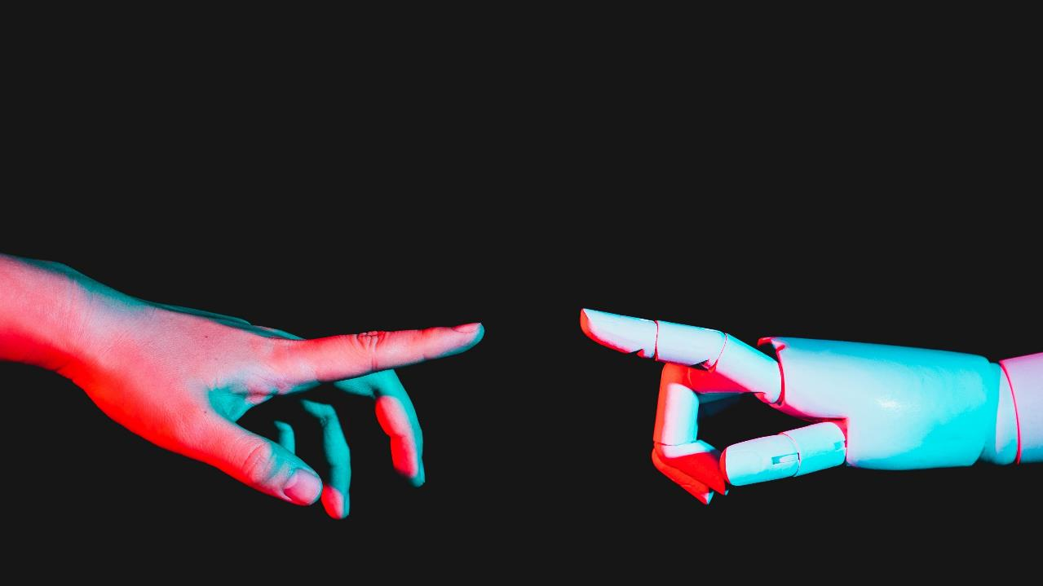
privacy every move you make on social media is recorded !

Slide 9
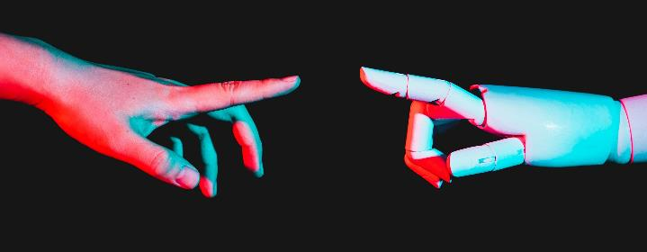
A COMPARISON OF POSITIVE AND NEGATIVE IMPACT OF SOCIAL MEDIA ON SOCIETY

Slide 10
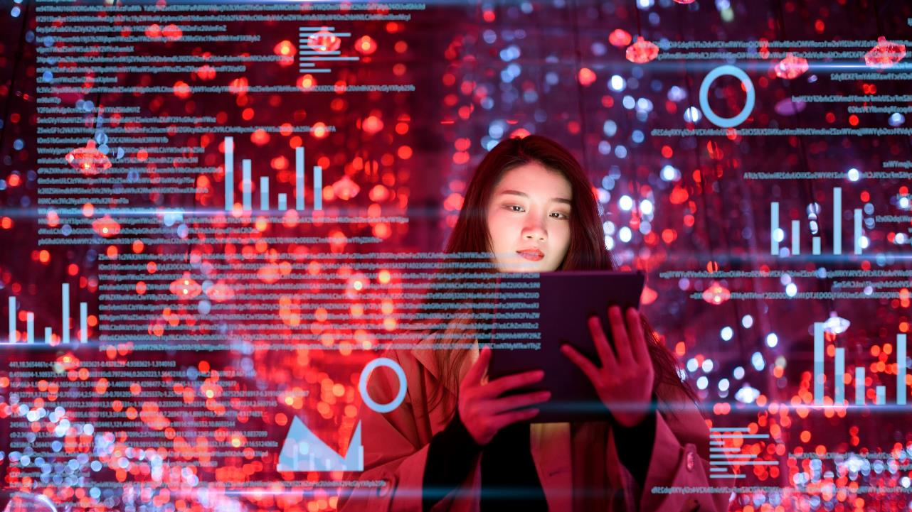
CONCLUSION
Social media has revolutionized communication and information sharing, but it also has negative impacts on mental health, privacy, and the spread of misinformation. As social media continues to evolve, we must remain mindful of its power and use it responsibly.

Slide 11
Q N A

Slide 12
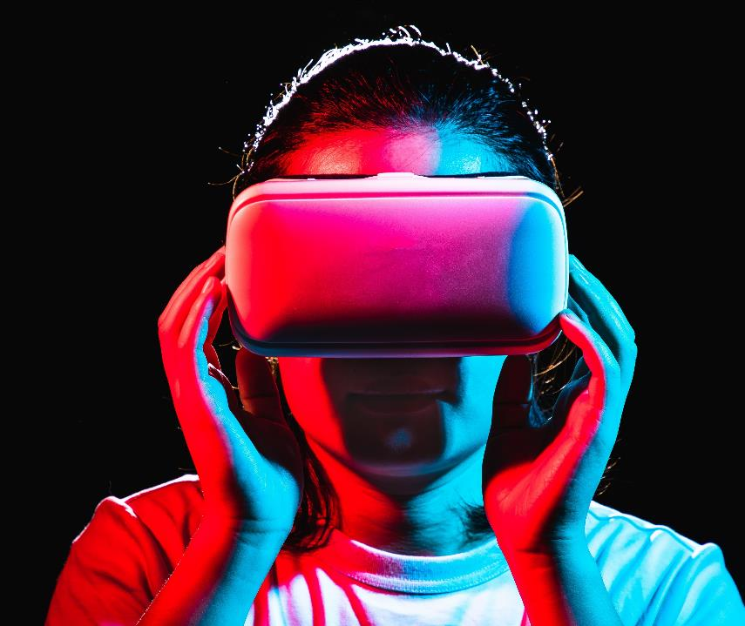
Thank you
ABDUL GHANI KHAN​​
BS – CS (1A)​
22P-9037
p22907@pwr.nu.edu.pk

